Slide 1
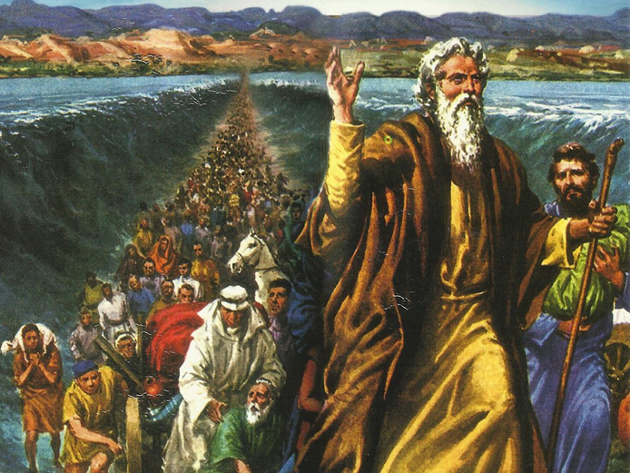
CATECHETICAL TEXTBOOK SERIES OF THE SYRO - MALABAR CHURCH
ON THE PATH OF SALVATION - 5
PEOPLE WHO AWAITED THE REDEEMER
5

Slide 2
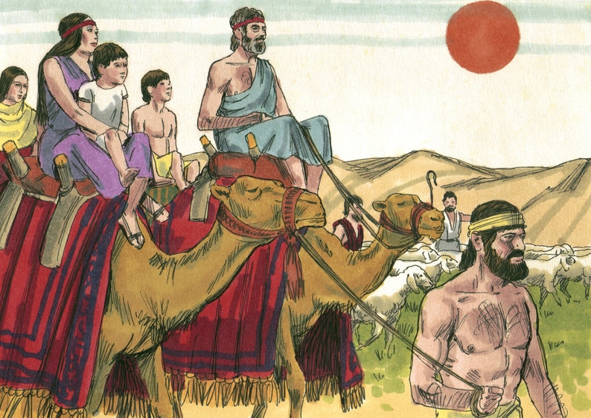
LESSON 10
IN THE PROMISED LAND

Slide 3
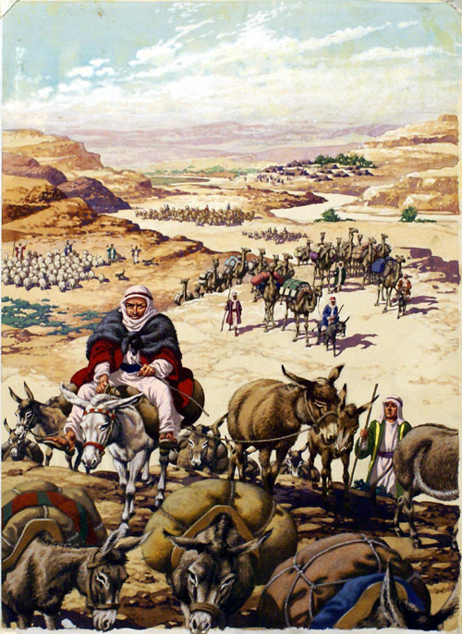
Israel, the chosen people defied God on several occasions. Each time God punished them, but later forgave them mercifully and showered them with blessings. In spite of all this they even doubted God’s promise of the promised land of Canaan, the land of milk and honey. God gave them suitable punishment. He said: As punishment for your faithlessness, your children shall wander in the desert as nomads for forty years… You must do penance for forty years in atonement for your misdeeds (Num. 14: 33-34).

Slide 4
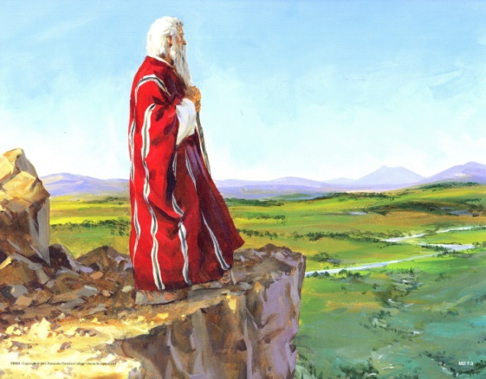
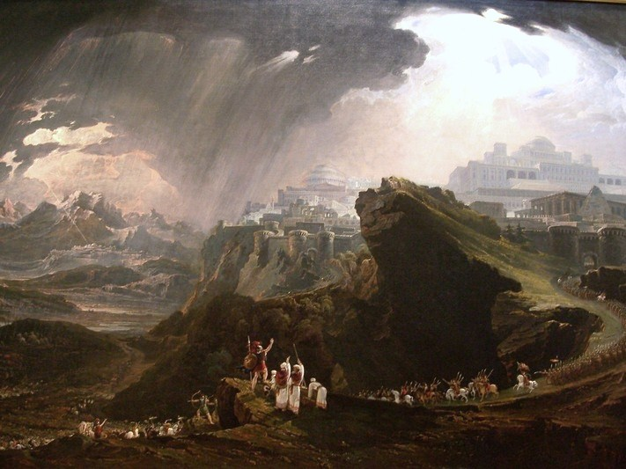
Death of moses
Moses was the leader of Israel since the days when they were liberated from slavery in Egypt. He was the prophet of God. Though Moses had many drawbacks, God engaged him for this mission giving him courage and strength.
“ This is the land, of which I swore to Abraham, to Isaac and to Jacob, saying, ‘I will give it to your descendants’; I have let you see it with your eyes, but you shall not cross over there” (Deut. 34:4).
There was never a prophet like Moses who spoke face to face with the Lord.

Slide 5
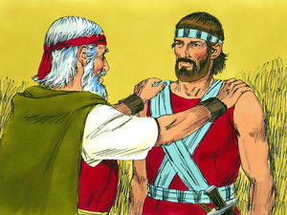
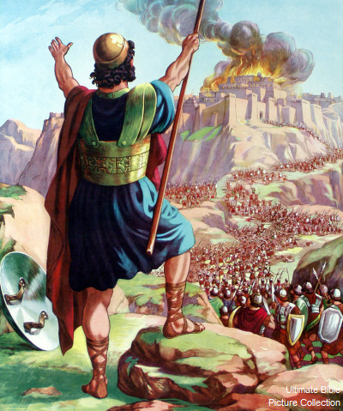
Leadership of joshua
Aaron whom God had given as assistant to Moses died earlier. God assigned Joshua as the successor to Moses to lead Israelites. Before his death Moses had blessed Joshua.
Moses summoned Joshua and said to him in the sight of all the Israelites: “Be strong and bold, for you are the one who will go with this people into the land that the Lord has sworn to their ancestors to give them, and you will put them in possession of it. It is the Lord who who goes before you. He will be with you; He will not fail you or forsake you. Do not fear or be dismayed” (Deut. 31:7-8).

Slide 6
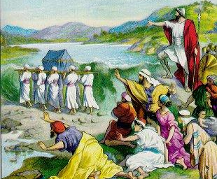
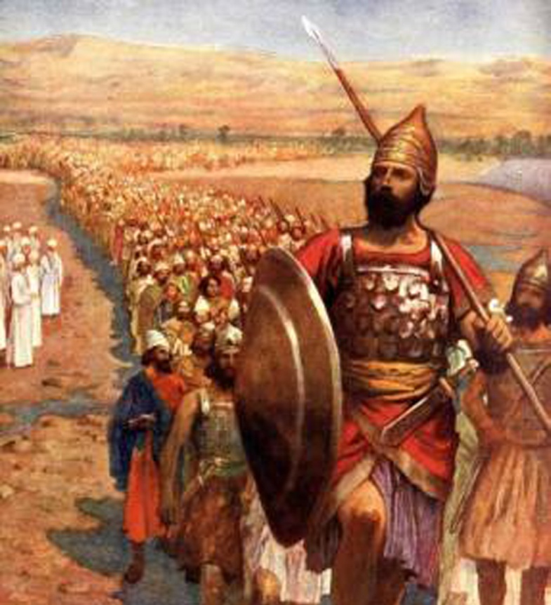
Entering the promised land
“ draw near and hear the word of God…. When the soles of the feet of the priests who bear the ark of the Lord, the Lord of all the earth, rest in the waters of Jordan, the waters of the Jordan flowing from above shall be cut off; they shall stand in a single heap”
The moment the priests touched water, the flow stopped. Dry land appeared in the river Jordan.

Slide 7
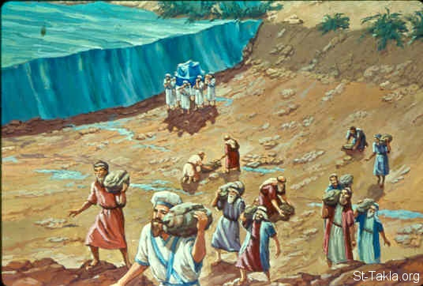
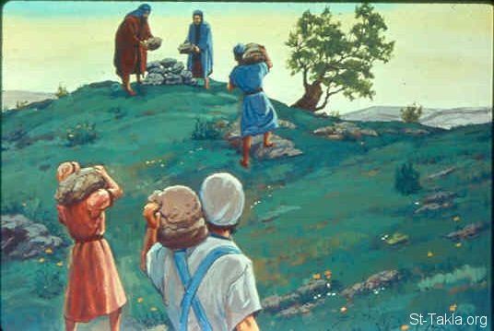
Erecting a monument
Once they had crossed the Jordan, the people erected a monument to God using twelve stones they collected from the riverbed, as God directed Joshua to do. Joshua asked the people to tell the following generations that this monument was in grateful memory of the miraculous crossing of the river Jordan. The place where they erected the monument was called Gilgal (Josh. 4:1-3).

Slide 8
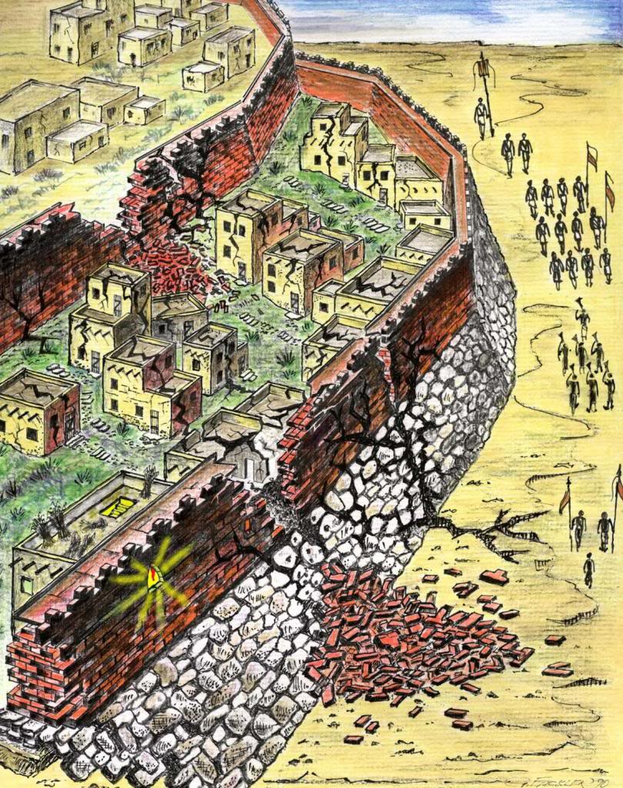
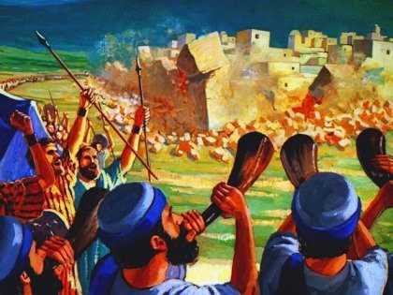
Conquering of canaan
The first city they conquered was Jericho. God helped the Israelites in a special way to occupy this city strongly fortified and surrounded by high walls (Josh. 6:1-21).
The phrase, “ the land where milk and honey flows” should be understood to mean a land where God’s blessing was available in abundance.

Slide 9
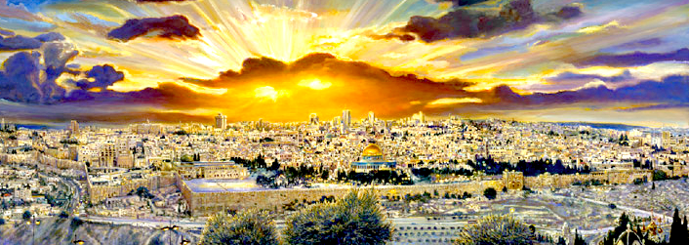
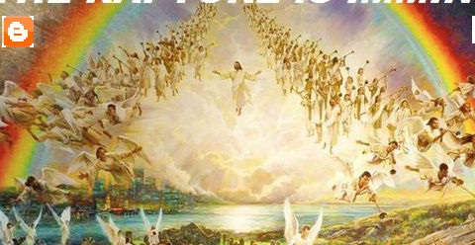
Heavenly jerusalem
The people of the New Testament also are on a long pilgrimage likes the Israelites of those days. Our pilgrimage is to a new land of Canaan that God, our loving father, has promised us through Jesus. At the end of this journey we will reach the goal, the heavenly Jerusalem.

Slide 10
Let us pray
O God who helped Israelites to reach the promised land, help us to reach heaven.

Slide 11
READ AND RECOUNT
Narrate the event of the Israelites miraculously crossing the river Jordan and reaching the land of Canaan (Joshua 3: 1-17)

Slide 12

WORD OF GOD FOR GUIDANCE
“ It is the Lord who goes before you, and he will be with you; he will not fail you or forsake you. Do not fear or be dismayed ” (Deuteronomy 31:8).

Slide 13
MY DECISION
Like the Israelites who travelled with Zeal to reach the land of Canaan, I will Lead a life with Zeal to reach heaven.

Slide 14
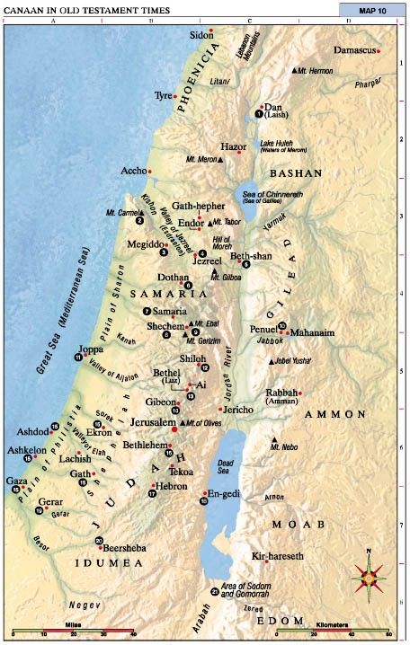
LET US DO
Mark the following places in the map River Jordan, land of Canaan.

Slide 15
LET US FIND OUT THE ANSWER
1. What kind of a prophet was Moses?
2. Whom did appoint as the successor of Moses?
3. Why did Joshua establish a monument at Gilgal?
4. What is the final goal of every human being?

Slide 16
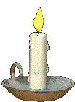


Thank you

